Slide 1
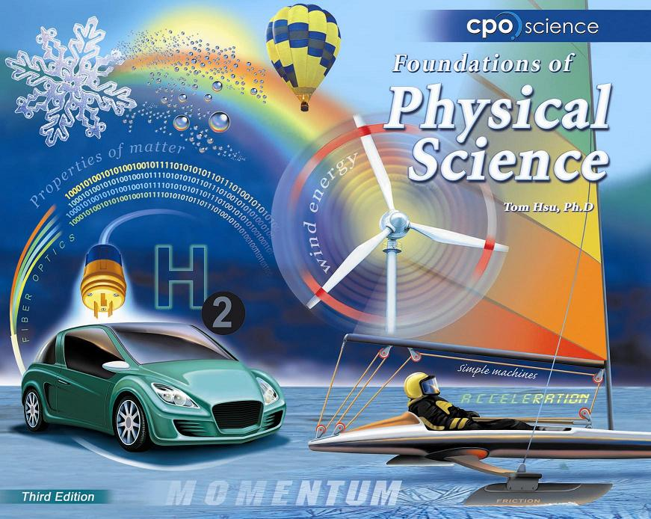

Slide 2
13.1 What’s in Earth’s atmosphere?
Nitrogen (N₂) gas makes up about 78 percent of Earth’s atmosphere.
Nitrogen is released into the air by volcanoes and decaying organisms and is a vital element for living things.

Slide 3
13.1 Comparing atmospheres
An atmosphere is a layer of gases surrounding a planet or other body in space.

Slide 4
13.1 Life changed Earth’s atmosphere
Over time, photosynthesis breaks down carbon dioxide, uses carbon to build the organism, and releases oxygen into the air.

Slide 5
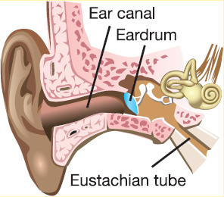
13.1 Atmospheric pressure
Atmospheric pressure is a measurement of the force of air molecules in the atmosphere at a given altitude.
Your ear drum is one way you can detect changes in pressure.

Slide 6
13.1 Pressure in the atmosphere
At sea level, the weight of the column of air above a person is about 9,800 newtons (2,200 pounds)!
This is equal to the weight of a small car.
Why aren’t we crushed by this pressure?

Slide 7
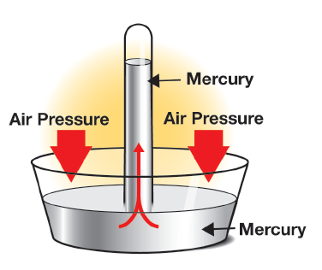
13.1 Measuring Pressure
A barometer is an instrument that measures atmospheric pressure.
Mercury barometers were common until we discovered their vapors were harmful.
https://ed.ted.com/lessons/the-history-of-the-barometer-and-how-it-works-asaf-bar-yosef

Slide 8
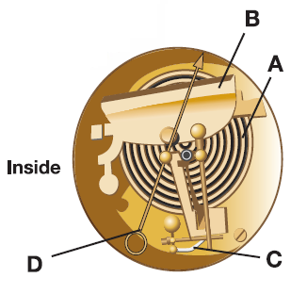
13.1 Measuring Pressure
Today we use aneroid barometers.
They have an airtight cylinder made of thin metal.
The walls of the cylinder respond to changes in pressure.

Slide 9
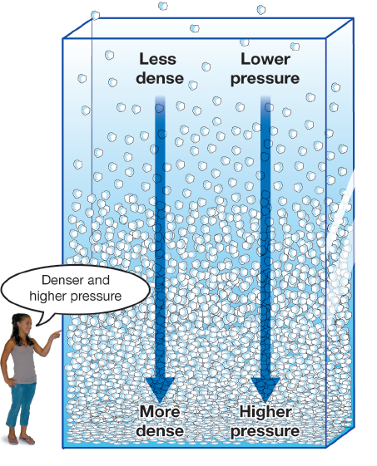
13.1 Pressure in the atmosphere
The gas molecules closest to Earth’s surface are packed together very closely.
This means pressure is lower the higher up you go into the atmosphere.

Slide 10
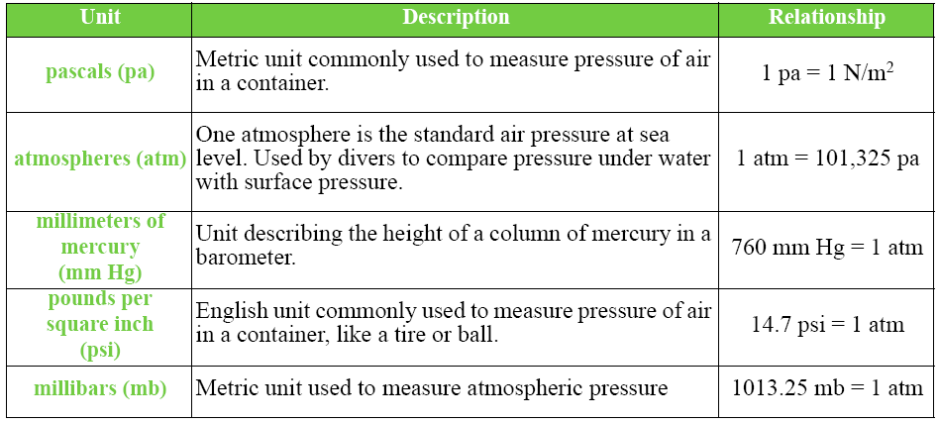
13.1 Units of pressure

