Slide 1
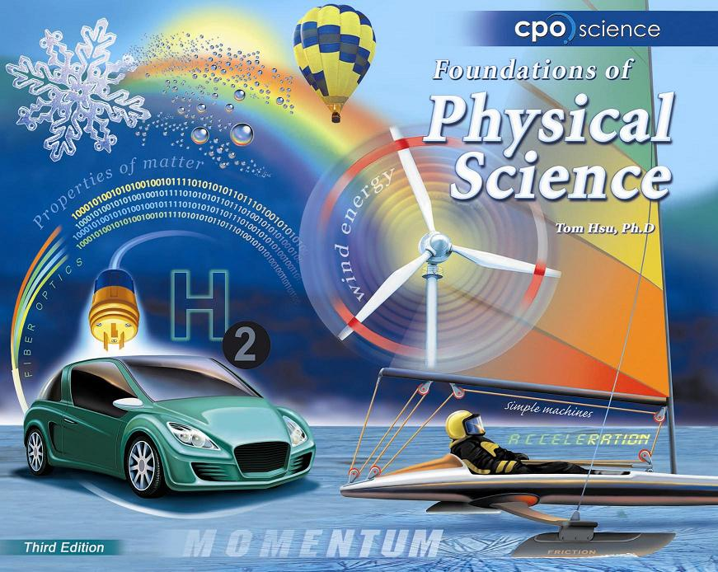

Slide 2
Chapter Thirteen: The Behavior of Gases
13.1 Gases, Pressure, and the Atmosphere
13.2 The Gas Laws

Slide 3
13.2 Boyle’s Law
When you squeeze a fixed quantity of gas into a smaller volume the pressure goes up.
This rule is known as Boyle’s law.

Slide 4
13.2 Boyle’s Law

Slide 5
Solving Problems
A kit used to fix flat tires consists of an aerosol can containing compressed air and a patch to seal the hole in the tire.
Suppose 5 liters of air at atmospheric pressure (1 atm) is compressed into a 0.5 liter aerosol can. What is the pressure of the compressed air in the can?
Assume no change in temperature or mass.

Slide 6
Solving Problems
Looking for:
  …final pressure in atmospheres (P₂)
Given
  …V₁ = 5 L , P₁= 1 atm, V₂ = .5 L
Relationships:
  Boyle’s Law: P₁V₁ = P₂V₂
Solution
  Rearrange equation so P₂ = P₁V₁ / V₂
  P₂ = 1atm x 5.0 L/ 0.5 L = 10 atm.

Slide 7
13.2 Pressure and Temperature
The pressure of a gas is affected by temperature changes.
If the mass and volume are kept constant, the pressure goes up when the temperature goes up, and down when the temperature goes down.

Slide 8
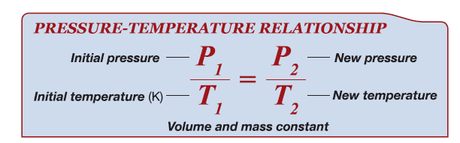
13.2 Gay-Lussac’s Law

Slide 9
13.2 Pressure and Temperature
Any time we apply gas laws, the the temperature must be in Kelvins.
Only the Kelvin scale starts from absolute zero, when energy of particles is theoretically zero.

Slide 10
13.2 Charles’ Law
According to Charles’ law, the volume of a gas increases with increasing temperature.
Volume decreases with decreasing temperature.

Slide 11
13.2 Charles’ Law
A hot-air balloon floats because the air inside is less dense than the air outside.

Slide 12
Solving Problems
A can of hair spray has a pressure of 300 psi at room temperature 21°C.
The can is accidentally moved too close to a fire and its temperature increases to 295°C.
What is the final pressure in the can? (Round answer to nearest whole number.)

Slide 13
Solving Problems
Looking for:
  …final pressure in atmospheres (P₂)
Given
  …P₁= 300 atm, T₁ = 21 °C , T₂ = 295 °C
Relationships:
  Convert temps using K = °C + 273
  Charles’ Law: P₁/T₁ = P₂/T₂
Solution
  Rearrange equation so P₂ = P₁xT₂ / T₁
  P₂ = 300 atm. x 568K / 294K = 580 atm.

