Slide 1
Table of Contents
Chapter 14
History of Life
Section 1 Biogenesis
Section 2 Earth’s History
Section 3 The First Life-Forms

Slide 2
Objectives
Section 1 Biogenesis
Chapter 14
Compare the principle of biogenesis with the idea of spontaneous generation.
Summarize the results of experiments by Redi and by Spallanzani that tested the hypothesis of spontaneous generation.
Describe how Pasteur’s experiment disproved the hy
pothesis of spontaneous generation. https://www.youtube.com/watch?v=63IoOLXmzKg

Slide 3
Redi’s Experiment
Section 1 Biogenesis
Chapter 14
Before the 1600s, it was generally thought that organisms could arise from nonliving material by spontaneous generation.

Slide 4
Redi’s Experiment, continued
Section 1 Biogenesis
Chapter 14
Redi showed in 1668 that rotting meat kept away from flies would not produce new flies.
Maggots appeared only on meat that had been exposed to flies.

Slide 5
Spallanzani’s Experiment
Section 1 Biogenesis
Chapter 14
Spallanzani showed in the 1700s that microorganisms would not grow in broth when its container was heated and then sealed.
He inferred that microorganisms do not arise spontaneously but, rather, are carried in the air.

Slide 6
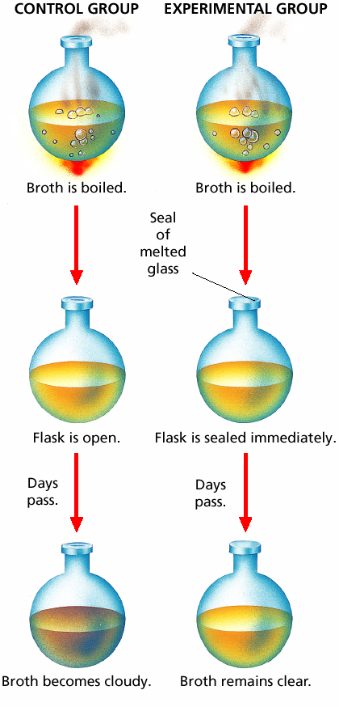
Spallanzani’s Experiment
Section 1 Biogenesis
Chapter 14

Slide 7
Pasteur’s Experiment
Section 1 Biogenesis
Chapter 14
Pasteur in the 1800s used a variation of Spallanzani’s design to prove that microorganisms are carried in the air and do not arise by spontaneous generation.

Slide 8
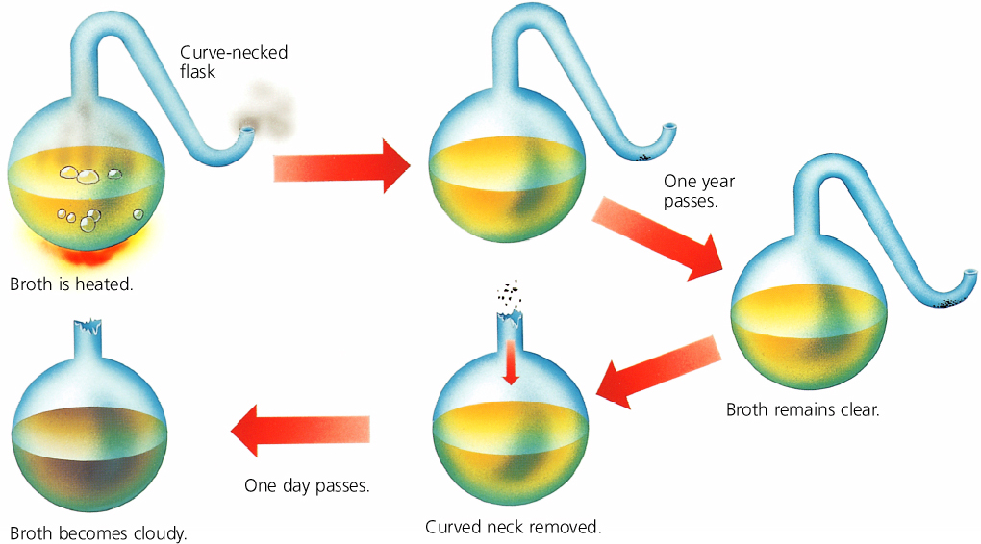
Pasteur’s Experiment
Section 1 Biogenesis
Chapter 14

Slide 9
Section 2 Earth’s History
Chapter 14
Objectives
Outline the modern scientific understanding of the formation of Earth.
Summarize the concept of half-life.
Describe the production of organic compounds in the Miller-Urey apparatus.
Summarize the possible importance of cell-like structures produced in the laboratory.

Slide 10
Section 2 Earth’s History
Chapter 14
The Formation of Earth
Earth’s Age
Scientists think that Earth formed more than 4 billion years ago by the gravitational accumulation of dust and debris moving through space.

Slide 11
Section 2 Earth’s History
Chapter 14
The Formation of Earth, continued
Radiometric Dating
Isotopes are atoms with varying numbers of neutrons.

Slide 12
Section 2 Earth’s History
Chapter 14
The Formation of Earth, continued
Radiometric Dating
The ages of rocks and other materials can be determined by measuring the amount of radioactive decay that has occurred in radioactive isotopes found in samples of those materials.
An isotope’s half-life is the time that one-half of a sample of the isotope takes to decay.

Slide 13
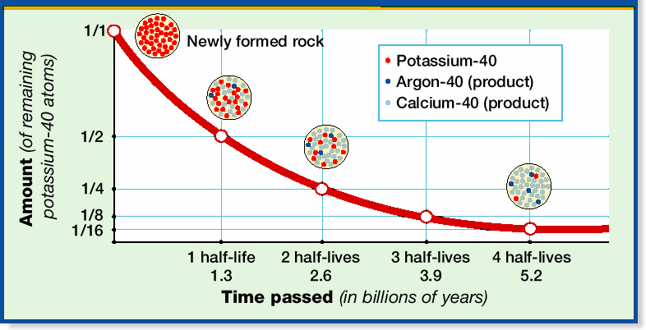
Radioactive Decay
Section 2 Earth’s History
Chapter 14

Slide 14
Section 2 Earth’s History
Chapter 14
Radiometric Dating
Click below to watch the Visual Concept.
Visual Concept

Slide 15
Section 2 Earth’s History
Chapter 14
First Organic Compounds
Synthesis of Organic Compounds
The first simple organic compounds on early Earth may have formed under conditions of high energy and in an atmosphere very different from that of today’s Earth.
Further chemical reactions may have converted simple organic compounds into the macromolecules important to life.
These conditions have been experimentally modeled.

Slide 16
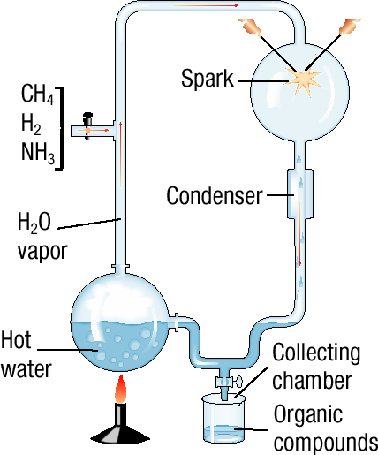
Miller-Urey Experiment
Section 2 Earth’s History
Chapter 14

Slide 17
Section 2 Earth’s History
Chapter 14
First Organic Compounds, continued
Organic Compounds from Beyond Earth
Meteorites may have brought organic compounds to Earth.

Slide 18
Section 2 Earth’s History
Chapter 14
From Molecules to Cell-Like Structures
Cell-like structures, including microspheres and coacervates, form spontaneously in certain kinds of solutions.
These structures could have been a step in the formation of modern cells but lack hereditary material.

Slide 19
Section 2 Earth’s History
Chapter 14
From Molecules to Cell-Like Structures, continued
Scientists continue to investigate many hypotheses about the origins of organic molecules and cells in Earth’s history.

Slide 20
Section 3 The First Life-Forms
Chapter 14
Objectives
Explain the importance of the chemistry of RNA in relation to the origin of life.
List three inferred characteristics that describe the first forms of cellular life on Earth.
Compare the two types of autotrophy used by early cells.
Relate the development of photosynthesis to the development of aerobic respiration in early cells.
Explain the theory of endosymbiosis.

Slide 21
Section 3 The First Life-Forms
Chapter 14
The Origin of Heredity
The first molecule that held hereditary information may have been RNA rather than DNA.

Slide 22
Section 3 The First Life-Forms
Chapter 14
The Roles of RNA
In addition to serving as a template for protein assembly, some RNA molecules can act as self-replicating enzymes and are called ribozymes.

Slide 23
Section 3 The First Life-Forms
Chapter 14
The First Cells
The first cells that formed on Earth were probably heterotrophic prokaryotes.

Slide 24
Section 3 The First Life-Forms
Chapter 14
The First Cells, continued
Chemosynthesis
The first autotrophic cells probably used chemosynthesis to make food.
Chemosynthesis produces energy through the oxidation of inorganic substances, such as sulfur.

Slide 25
Section 3 The First Life-Forms
Chapter 14
The First Cells, continued
Photosynthesis and Aerobic Respiration
Most modern autotrophic cells, such as cyanobacteria, use photosynthesis to make food.
An important byproduct of photosynthesis is oxygen.

Slide 26
Section 3 The First Life-Forms
Chapter 14
The First Cells, continued
Photosynthesis and Aerobic Respiration
Once oxygen began to accumulate on Earth, cells would need to bind oxygen to other compounds in order to prevent damage to cell enzymes.
This binding function may have been a first step toward aerobic respiration in cells.

Slide 27
Section 3 The First Life-Forms
Chapter 14
The First Eukaryotes
Eukaryotic cells may have evolved from large prokaryotic cells that engulfed smaller prokaryotic cells. This is known as the theory of endosymbiosis.
The engulfed prokaryotic cells may have become the ancestors of organelles such as mitochondria and chloroplasts.

Slide 28
Section 3 The First Life-Forms
Chapter 14
Origin of Eukaryotic Cells
Click below to watch the Visual Concept.
Visual Concept

