Slide 1
Bell Ringer
http://studyjams.scholastic.com/studyjams/jams/science/scientific-inquiry/scientific-theory-and-evid.htm

Slide 2
Hypothesis, Theory, and law
How science really works
Objective: Students will be able to explain what a scientific law and theory are and give examples of each.
Essential Question: What are the differences between a scientific law and theory?

Slide 3
What is a scientific hypothesis?
A hypothesis is a possible answer to a scientific question.
A scientific hypothesis is not a guess!
Hypotheses are based on:
Prior experience
Scientific background knowledge
Preliminary observations
Logic
In this class, we state hypotheses as “If, then, because” statements.
If the type of vehicle is changed, then a car will have a higher mpg rating than a truck, because lighter vehicles use less gas per mile than heavier vehicles.

Slide 4
Scientific Hypothesis
The format of a good hypothesis:
If {tested/independent variable} is changed, then {prediction about outcome/dependent variable}, because {research that supports the prediction}.
The hypothesis should clearly state the predicted relationship between the tested/independent and outcome/dependent variables, and it must include the background knowledge you use to make that prediction.

Slide 5
Scientific Theory
Theories are not educated guesses either!
Theories are explanations for how nature works.
Theories explain a major phenomenon of nature.
Phenomenon: any observable event
Theories are well-supported with evidence, and are thought to be the best explanation of a phenomenon.

Slide 6
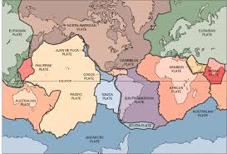
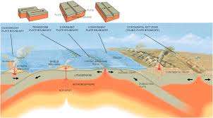
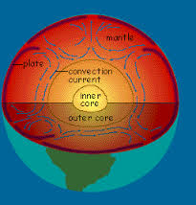
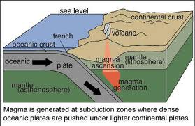
Examples of Theories
Theory of plate tectonics - is the theory that the outer rigid layer of the earth (the lithosphere) is divided into a couple of dozen "plates" that move around across the earth's surface relative to each other, like slabs of ice on a lake.

Slide 7
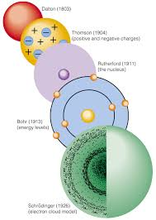
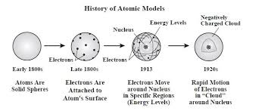
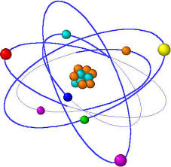
Examples of Theories
Atomic theory - is the idea that matter is made up of little units called atoms, or it can be defined as a theory of the structure of the atom

Slide 8
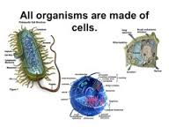
Examples of Theories
Cell theory– 1. All living things are made of cells. 2. Cells are the basic units of structure and function in living things. 3. Living cells come only from other living cells

Slide 9
Scientific Law
Scientific laws describe what nature does under certain conditions.
If those conditions are present, then the law can be used to make predictions about what will happen.
Phenomenon A always happens when conditions 1 and 2 are met.
Scientific laws are well-supported with evidence and have been tested repeatedly over time.

Slide 10
Relationship between theories and laws
Theories DO NOT become laws with more evidence.
Laws describe what happens and theories explain why it happens.
Theories are used to explain why a law can be used to predict what will happen under certain conditions.

Slide 11
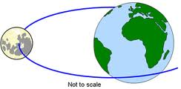
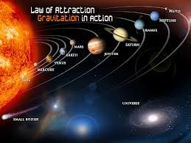
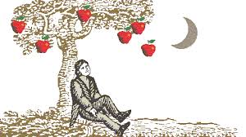
Examples of Laws
Law of universal gravitation~ states that the forces of gravity acts between all objects in the universe

Slide 12
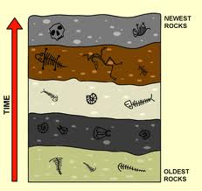
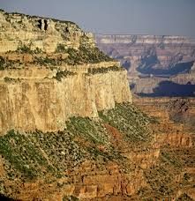
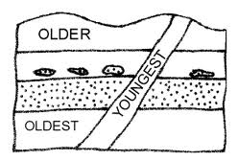
Examples of Laws
Law of superposition~ in undisturbed rock layers the oldest layer will be at the bottom and the youngest layer at the top

Slide 13
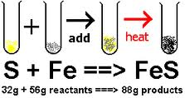
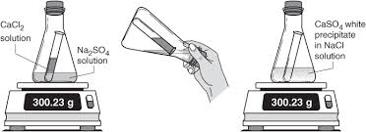
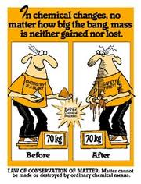
Examples of Laws
Law of conservation of mass~ matter cannot be created or destroyed, but it can change from one form to another

Slide 14
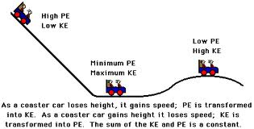
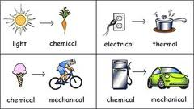
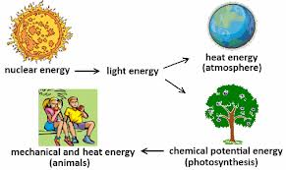
Examples of Laws
Law of conservation of energy~ energy cannot be created or destroyed, but it can change from one form to another

Slide 15
Scientific knowledge
Our knowledge of the natural world is always growing and changing.
Scientific knowledge is based on an ever-growing collection of facts about the natural world, but it changes with new evidence or new interpretations.

