Slide 1
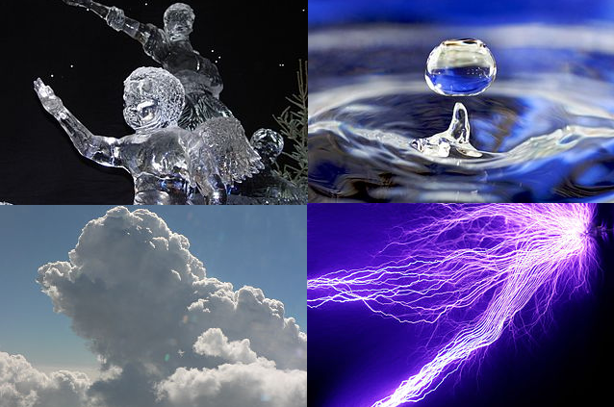
States of Matter

Slide 2
The Kinetic Theory:
All matter is composed of submicroscopic particles that are in constant motion.

Slide 3
If energy is added to these particles, their motion increase, and the greater the amount of energy, the faster the resulting motion.

Slide 4
Electrical forces attract atoms toward each other and inhibit the movement of the particles.

Slide 5
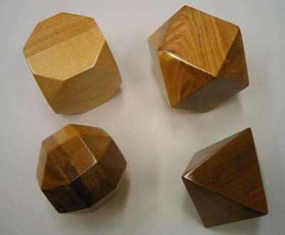
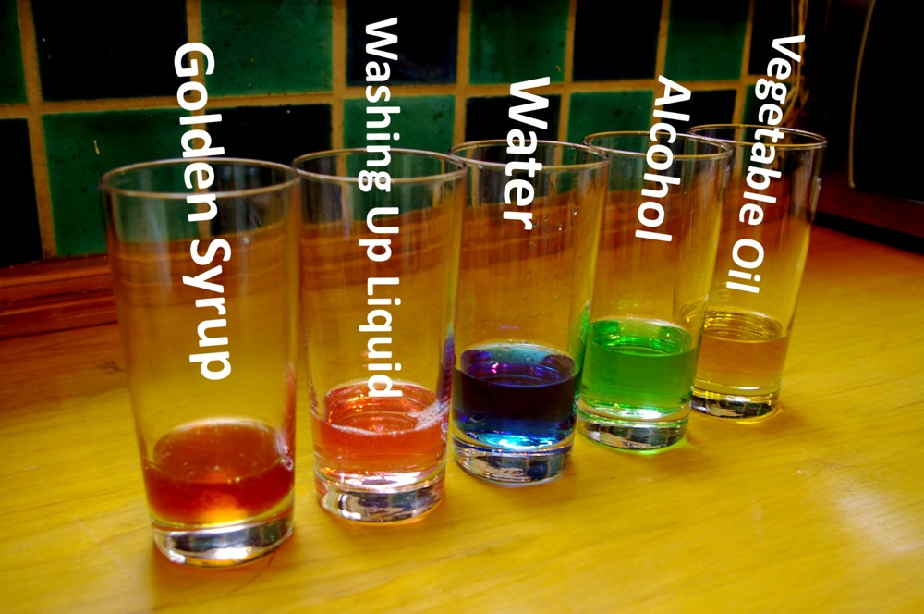
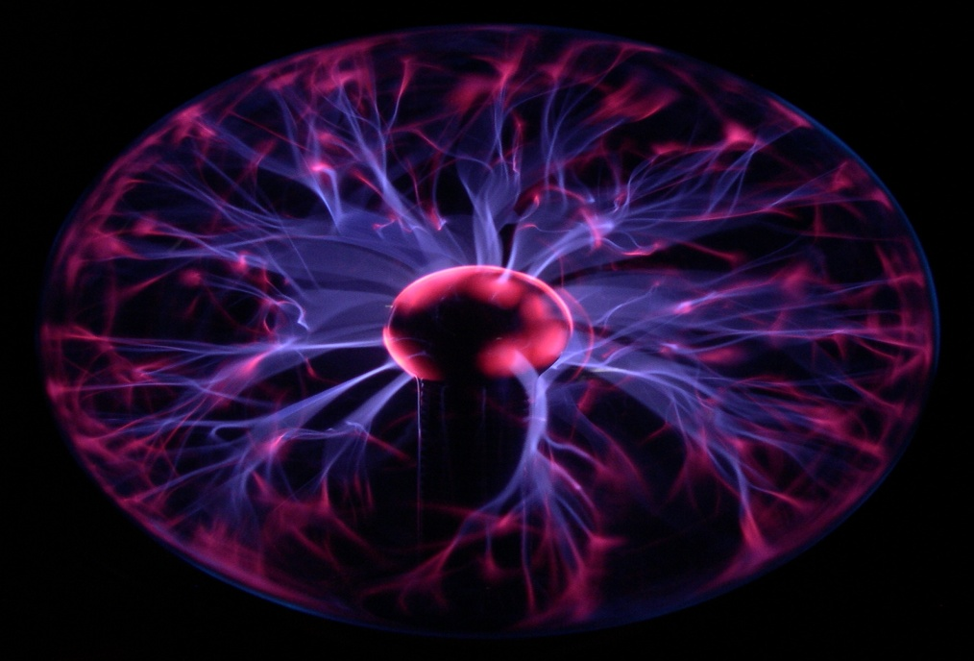
States of Matter!

Slide 6
Solids
Particles Energy is less than attractive forces present.
The attractive forces keep the particles in fixed positions with set distances between them.

Slide 7
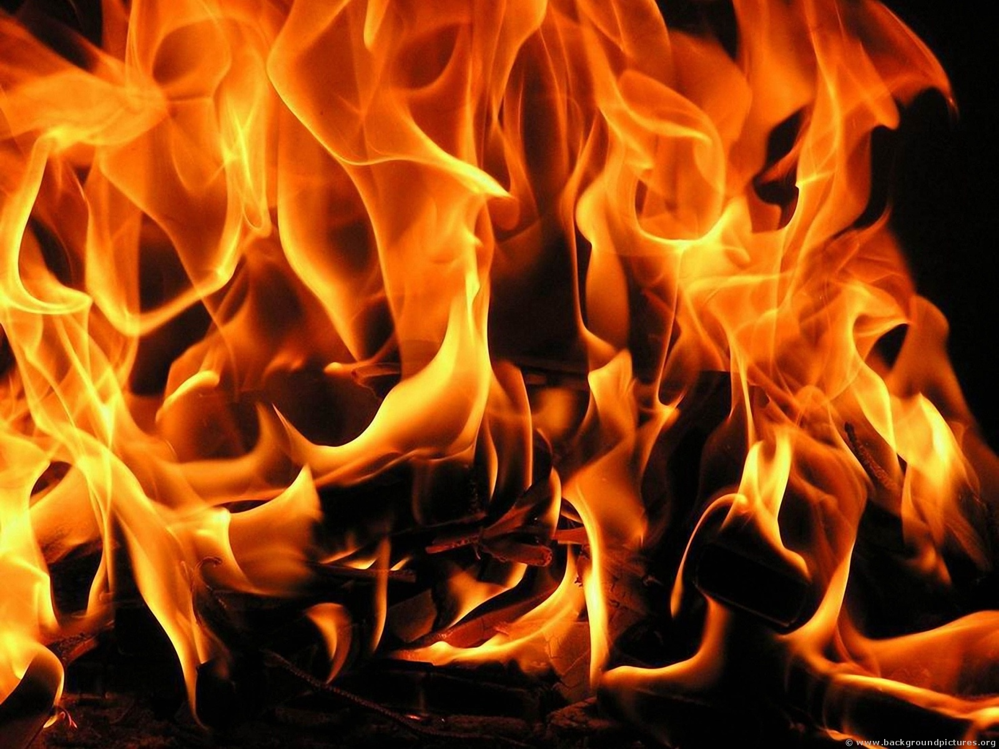
Liquids
When sufficient thermal energy is applied to a solid, its particles energy overcomes the attractive forces and it becomes a liquid.
The attractive force can still hold the particles closely together , but the energy gained allows limited motion or flow

Slide 8
Gases
As thermal energy is added to the particles in the liquid state, the overcome their attractive forces and the atmosphere pushing them together and they become gaseous particles.
Large amount of kinetic energy, move rapidly and randomly across great distances.

Slide 9
Plasma
Thermal energy is added to gas particles and the electrons can be stripped away from the nucleus.
Most abundant
Electrons
Neutral atoms
ions

Slide 11
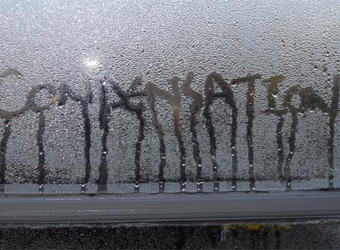
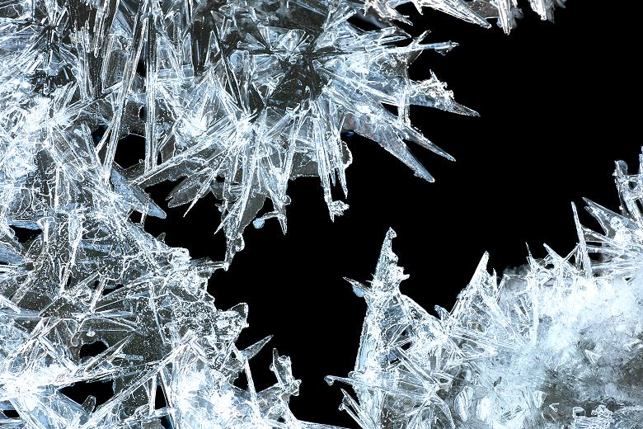
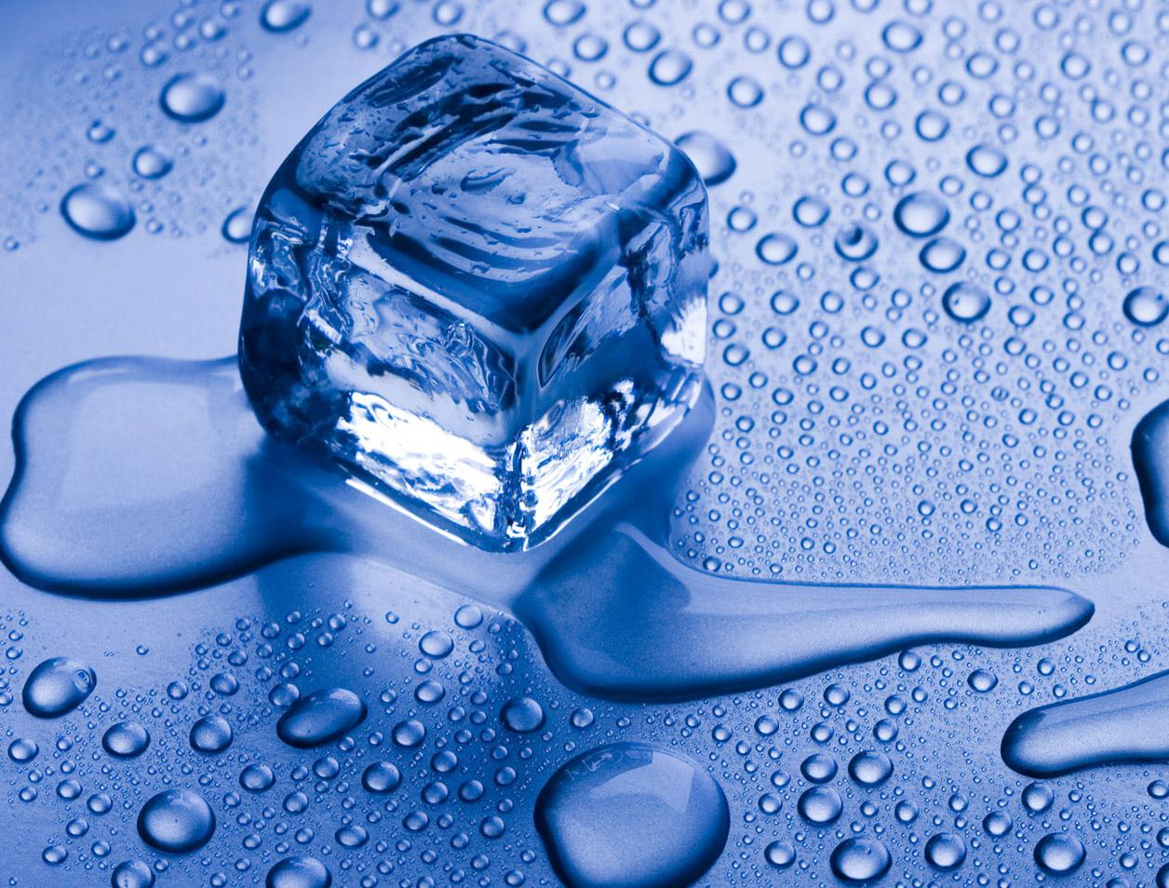
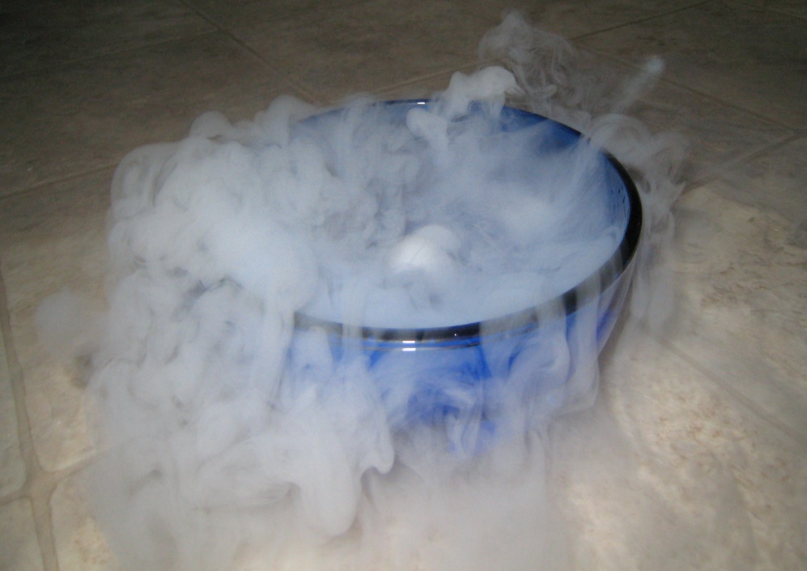
Phase changes

Slide 12
Condensation
Condensation
Process | As gas is cooled
Energy lost or gain | Lost
Results | Less motion Attractive force overcomes energy
Change | Gas to a Liquid

Slide 14
Freezing
 | Freezing
Process | As liquid is cooled
Energy lost or gain | lost
Results | Attractive forces hold the particles tightly packed in fix positions
Change | Liquid to a Solid

Slide 15
Melting
 | Melting
Process | As solid is heated
Energy lost or gain | gain
Results | More energy overcome the attractive force and allows the molecules to flow
Change | Solid to Liquid

Slide 17
Sublimation
 | Sublimation
Process | A solid that has extremely low temperatures is put in contact with an environment that has a higher temperature
Energy lost or gain | Rapidly gained
Results | The particles have a high amount of energy and can overcome the attractive forces without passing the liquid state
Change | Solid changed directly into a gas.

