Slide 1
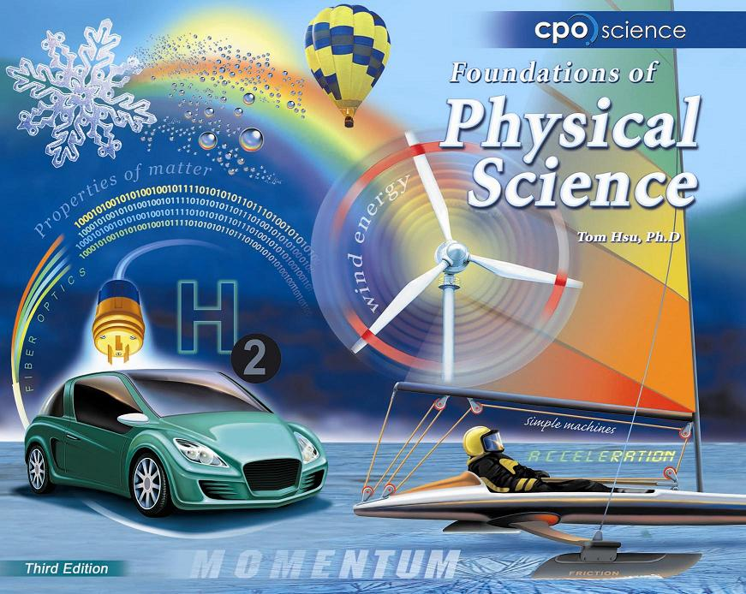

Slide 2
Chapter Ten: Matter and
Temperature
10.1 The Nature of Matter
10.2 Temperature
10.3 The Phases of Matter

Slide 3
10.2 Temperature
There are two common temperature scales.
On the Fahrenheit scale, water freezes at 32 degrees and boils at 212 degrees.
The Celsius scale divides the interval between the freezing and boiling points of water into 100 degrees.

Slide 4
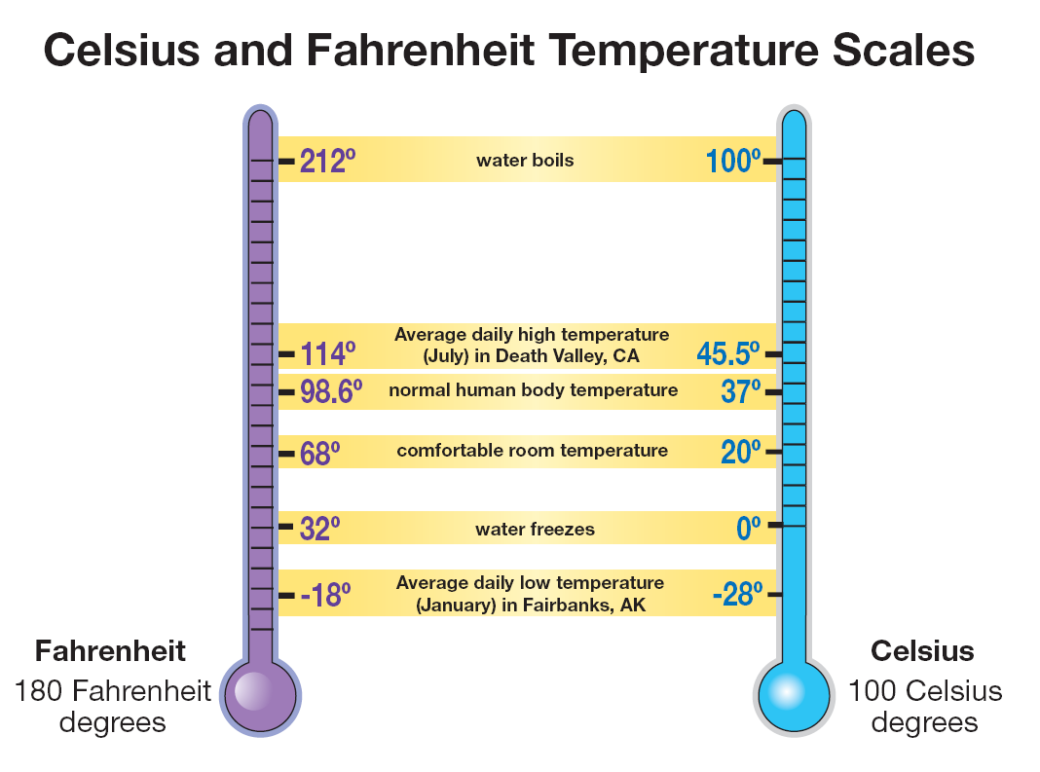

Slide 6
Solving Problems
A friend in Paris sends you a recipe for a cake. The French recipe says to bake the cake at a temperature of 200 °C for 45 minutes.
At what temperature should you set your oven, which uses the Fahrenheit scale?

Slide 7
Solving Problems
Looking for:
  …temperature in degrees Fahrenheit
Given:
  …temperature 200 °C
Relationships:
  T_{F} = 9/5 T_{C} + 32
Solution
  T_{F} = (9/5)(200 °C) + 32 = 392 °F

Slide 8
10.2 What temperature really is
Atoms are in constant motion, even in a solid object.
The back-and-forth jiggling of atoms is caused by thermal energy, which is a kind of kinetic energy.

Slide 9
10.2 What temperature really is
Temperature measures the kinetic energy per molecule due to random motion.

Slide 10


10.2 Thermometers
A thermometer is an instrument that measures the exact temperature.
Most thermometers contain either a silvery fluid (mercury) or a red fluid, which is alcohol containing a small amount of red dye.

Slide 11
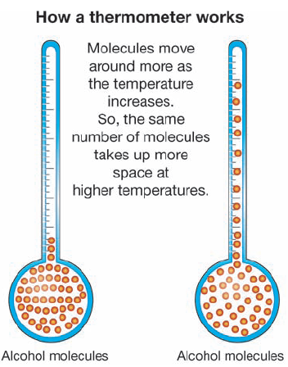
10.2 How a thermometer works
The volume of alcohol in a thermometer contains huge numbers of alcohol molecules.
As temperature increases, the alcohol molecules move faster and bounce off each other.
The liquid alcohol expands and takes up more space in the thermometer.

Slide 12
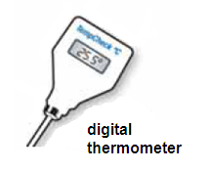
10.2 Measuring temperature
A thermistor is a device that changes its electrical resistance as the temperature changes.
Some digital thermometers sense temperature by measuring the resistance of electrons passing through wire.

Slide 13
10.2 Liquid-crystal thermometers
Some thermometers contain liquid crystals that change color based on temperature.
As temperature increases, the molecules of the liquid crystal bump into each other more and more.
This causes a change in the structure of the crystals, which in turn affects their color.

Slide 14
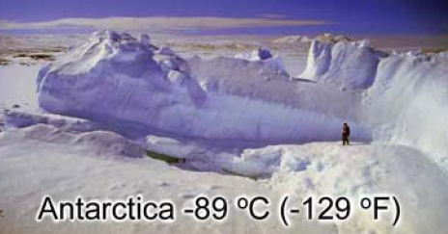
10.2 Absolute zero
Absolute zero is -273°C.
You cannot have a temperature lower than absolute zero.
Think of absolute zero as the temperature at which atoms are “frozen.”

Slide 15
10.2 Converting to Kelvin
The Kelvin temperature scale is useful in science because it starts at absolute zero.
To convert from Celsius to Kelvin, you add 273 to the temperature in Celsius.

