Slide 1
10.3 Phases of Matter
On Earth, pure substances are usually found as solids, liquids, or gases.
These are called phases of matter.

Slide 2
10.3 The phases of matter
A solid holds its shape and does not flow.
The molecules in a solid vibrate in place, but on average, don’t move far from their places.

Slide 3
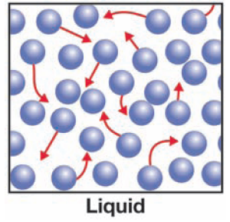
10.3 The phases of matter
A liquid holds its volume, but does not hold its shape—it flows.
Liquids flow because the molecules can move around.

Slide 4
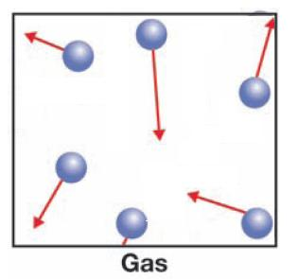
10.3 The phases of matter
A gas flows like a liquid, but can also expand or contract to fill a container.
A gas does not hold its volume.
The molecules in a gas have enough energy to completely break away from each other.

Slide 5
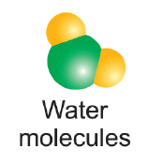
10.3 The phases of matter
When they are close together, molecules are attracted through intermolecular forces.

Slide 6
10.3 The phases of matter
The forces in chemical bonds are stronger than intermolecular forces.

Slide 7
10.3 Intermolecular forces
Within all matter, there is a constant competition between temperature and intermolecular forces.
When temperature wins the competition, molecules fly apart and you have a gas.
When intermolecular forces win the competition, molecules clump tightly together and you have a solid.

Slide 8
10.3 Melting and boiling
The melting point is the temperature at which a substance changes from a solid to a liquid.

Slide 9
10.3 Melting and boiling
The temperature at which a liquid becomes a gas is called the boiling point.

Slide 10
Notice temperature is constant while ice melts!
Notes:
As heat energy is added to ice, the temperature increases until it reaches 0°C.
Then the temperature stops increasing.
As you add more heat, more ice becomes liquid water but the temperature stays the same.
This is because the added energy is being used to break the intermolecular forces and change solid into liquid.
Once all the ice has become liquid, the temperature starts to rise again if more energy is added.

Slide 11
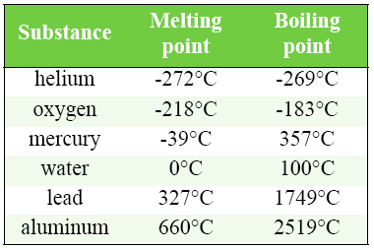
10.3 Melting and boiling points of common substances
Materials have a wide range of melting and boiling points.

Slide 12
10.3 Sublimation
Sometimes a solid can change directly to a gas when heat energy is added.
This process is called sublimation.

